Slide 1



LAMBDA EXPRESSIONS & LINQ

Slide 2
Introduction
Expressions that use special syntax
Anonymous functions used as data (variables, fields, parameters, return values)
The anonymous functions are used to create delegates and expression trees
Lambda expressions particularly helpful for writing LINQ queries
Available from .NET 4.5

Slide 3
Operator =>
Interpreted as “goes to”
Used for declaring a lambda expression
The same priority as assignment (=)
Right associative operator
Separates the parameters and function body
Left side
=>
Right side
An Empty parameter list A formal parameter list An implicit parameter list
An expression
A Statement list inside curly brackects.

Slide 4
Anonymous functions
Inline statements or expressions
Used wherever a delegate type is expected
It can initialize a named delegete
It can be passed as the parameter where a named delegate type is expected
Two kinds of anonymous functions
Anonymous methods
Lambda expressions

Slide 5
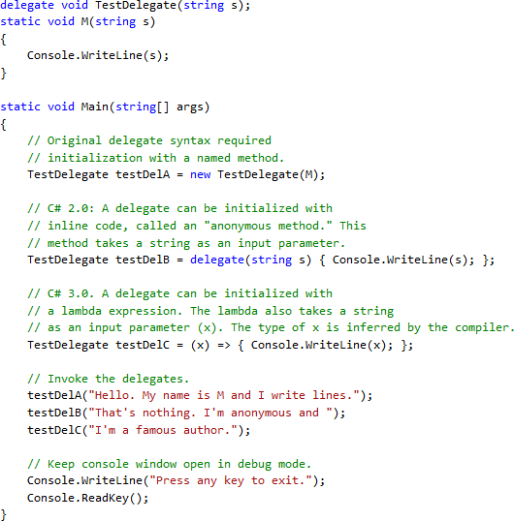









Evolution of delegates in C#
Named method
Inline code (anonymous method)
Lambda expression

Slide 6

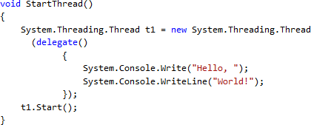
Anonymous method
No name, no overloading
Created using the delegate keyword
It is possible to add multiple statements inside its body

Slide 7
Anonymous method (cont.)
Scope of the parameters is the anonymous method block
No jump from inside an anonymous method block to the outside, and vice versa.
Cannot access ref and out parameters of an outer scope
No unsafe code access inside its block
Not allowed on the left side of the operator
is.

Slide 8
Expression lambdas
Lambda expression with an expression on the right side of the operator =>
Used dominantly in construction of expression trees
(input parameters) => expression
Parentheses optional if lambda has one param.
Input parameters separated by comma

Slide 9
Expression lambdas - examples
(x, y) => x == y
The parameters types inferred by the compiler
(int x, string s) => s.Length > x Specify types of the parameters when the compiler cannot inferre them from the code.
() => SomeMethod()
Zero input parameters specified with empty parentheses.
Note: a method call cannot be evaluated outside the .NET Framework (e.g. SQL Server)

Slide 10

Statement lambdas
(input parameters) => {statement;}
Statements enclosed in braces
The body of a statement lambda can contain multiple statements (in practices, two-three)
Cannot be used to create expression trees

Slide 11





Generic delegates – Func
System.Func<T,TResult>
T – argument type,
TResult – return type (last type parameter)
Useful for encapsulating user-defined expressions that are applied to all elements of
a data set
A generic declaration of the delegate Func.
Example of usage.

Slide 12











Func delegate (cont.)
A lambda expression can be passed where Expression<Func> type is required
– System.Linq.Queryable
Output: 5, 1, 3, 9, 7
Compiler can infere the type of the parameter n.
Output: 5, 4, 1, 3
Output: 5, 4

Slide 13



Type inference in lambdas
Compiler can infer the type of the parameters based on:
Lambda’s body
Parameter’s delegate type
Example:
IEnumerable<Customer> customers=...
Standard query operator.

Slide 14
Lambda expressions – general rules
The lambda must contain the same number of parameters as the delegate type
Each input parameter in the lambda must be implicitly convertible to its corresponding delegate parameter
The return value of the lambda (if any) must be implicitly convertible to the delegate’s return type

Slide 15
Lambda expressions - examples
Func<int,int> f1 = x => x+1;
Func<int,int> f2 = x => {return x+1;}
Func<int,int> f3 = (int x) => x +1;
Func<int,int> f4 = (int x) => {return x+1;}
Func<int,int> f7 = delegate(int x) {return x+1;}
Invocation example: Console.Writeln(f1.Invoke(4));

Slide 16
Lambda expressions - examples
Func<int,int,int> f5= (x,y) => x*y
Invocation: Console.Writeln(f5.Invoke(2,2));
Action f6 = () => Console.Writeline(); Function instance that does not receive any parameter nor returns value.
Invocation: f6.Invoke();
Func<int> f8 = delegate { return 1+1;}
Invocation: Console.Writeln(f8());

Slide 17
Language Integrated Query
LINQ

Slide 18
Content
Undestand what LINQ is?
Learn what problems solves
See what its syntax looks like
Know where LINQ can be used

Slide 19
What is LINQ?
Language INtegrated Query
It is part of programming language syntax
Supported by: C#, VB, Delphi Prism
Used for querying data
Supported the following types of data sources
Relational data
XML data
objects

Slide 20
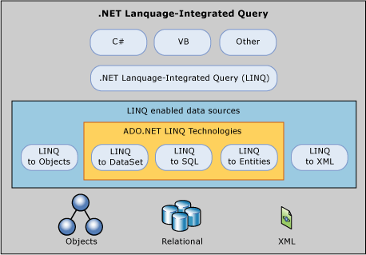
LINQ Architecture

Slide 21
ADO .NET vs. LINQ
ADO .NET
OO library for relational data access
Mapping from relational to
OO objects needed!
High Impedance Missmatch for mapping data from storage to objects in an application
LINQ
SQL-Like syntax that deals with pure objects
Reduces the Impedance
Missmatch
Makes data querying more efficient
One still must know the
format of the data

Slide 22
LINQ Adapters
LINQ to Objects
LINQ to SQL
LINQ to XML
LINQ to Entities
It is possible to create own customized adapter
– E.g. LINQ for Querying Twitter API

Slide 23
References
ASP .NET MVC 5 Tutorial – Official http://www.asp.net/mvc/tutorials/mvc- 5/introduction/getting-started
Lambda expressions http://www.dotnetperls.com/lambda
LINQ
http://code.msdn.microsoft.com/101-LINQ- Samples-3fb9811b

